Slide 1

Algorithms, Variables & Operators

Slide 2
Homework Check and Recap
Your time to speak !

Slide 3
What is Programming
Programming is the act of instructing computers to carry out tasks - It is often referred to as coding
What is a computer program: A computer program is a sequence of instructions that the computer executes.
Analogies of Programming
Programmer vs. Developer
Office vs. Freelance
Ex: Digitalisation of any problem that was previously done by hand / Excel

Slide 4
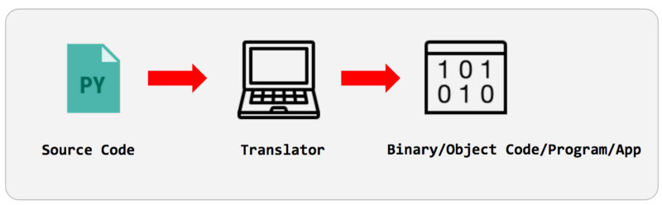
Language Translators
Interpreters: execute line by line
Compilers: execute whole binary file
Hybrids: both, ex: Java
Assemblers: Assembly to binary
Notes:
By Our Audience we mean: describe the typical demographics in the classrooms like we have everyone from age 15 till 40+, boys and girls, working and students, etc. THis program is designed for everyone

Slide 5
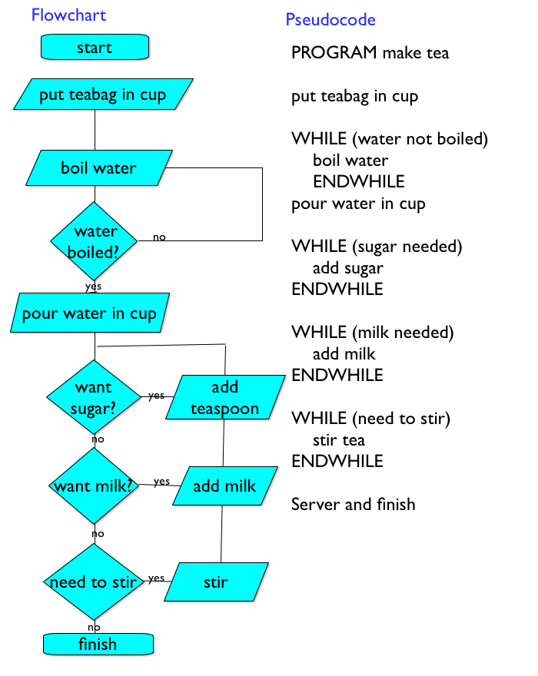
Algorithm
“Most optimal solution to a problem”
What is a Flowchart?
What is a Pseudocode?
Let’s solve:
Ex1: by me
Ex2: together
Ex3: by you
Notes:
Bu Slidedan sonra draw.io-da 2-3 xirda besit misal ishlenilsin
1 misali muellim ozu ishlesin
1 misal telebelerle birlikde
1 misal da ozleri hell elesinler

Slide 6
Variables and Operators
+.-,*,/,%, <> =, etc.
VAR
Declaration and Overwriting
Compare to JavaScript and PHP
True and False
Notes:
Bayaqki Flowchart misallarinda ise bezi ededlerin yerine acaba variable elave edib heyatimizi asantlashdira bilerikmi ?
TIme to open Visual Studio, console applciation . COx da detallara girishmeyin, just show them around with operators and variables, and show that it is quite similar in JS and PHP as well

Slide 7
Homework
2 Algorithms to be represented in a Flowchart
Notes:
2 algorithms of teachers choice

Slide 8
Thanks!

